Slide 1









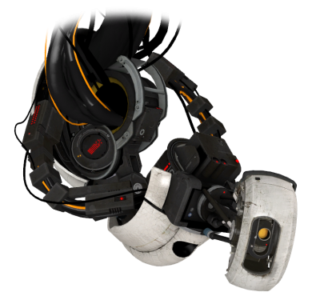




“PerformoBot,
please help me!”
Chatbot-supported Performance Evaluation
06.11.2019
performobot@gmail.com
@PerformoBot
Samuel Beck
Lasse Merz
Christoph Zorn
Fabian Beck
Leonel Merino
Dušan Okanović
André van Hoorn
@samu_beck
@beck_fabian
@leonel_merino
@okanovic_d
@andrevanhoorn
Notes:
chatbot
easier configuration, execution, and reporting of performance analysis

Slide 2








Motivation
Performance Evaluation
ChatBot
System
Eve
Colin
Mia
Notes:
Eve the performance evaluation expert knows how to do performance evaluations for the system
Colin the coworker and mia the manager do not
Therefore, the chatbot should help them to facilitate this process
Chatbots understand natural language, no domain knowledge needed, provide explanations, help users

Slide 3

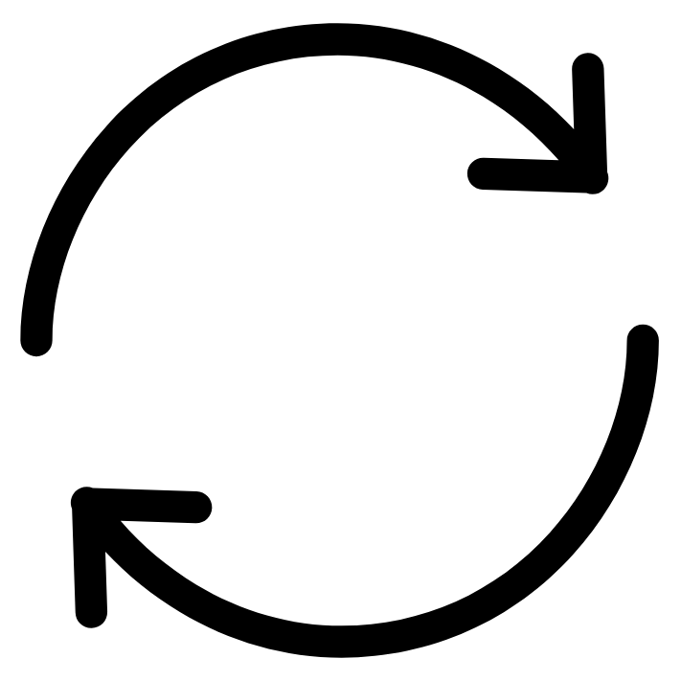

Goals
Evaluate the applicability of a chatbot to facilitate performance evaluations.
Gather impressions from performance experts and novices about using a chatbot in this context.
I want to test Eve’s system.
I want to perform a load test for Eve’s system.
Perform a load test with 100 users and measure response time.
Notes:
Goals were to evaluate chatbots in terms of their ability to facilitate performance evaluation
And see how people feel about it
Goal was to develop a chatbot wich can understand different user concerns based on different experience levels
Like novice, casual, and expert
All can get the same result in the end through the interaction

Slide 4


Approach
User Interaction
Language Processing
Analysis & Reporting
Eve
Mia
Colin
PerformoBot
Notes:
In praxis, chatbot developed with dialogflow, google's chatbot framework
Dialogflow used for natural language identification
Performobot has individual responses dependent on the users messages
After creating a load test set-up it gets send to analysis & reporting
Automatically executes a load test with JMeter and creates a corresponding report which is send back to the user

Slide 5
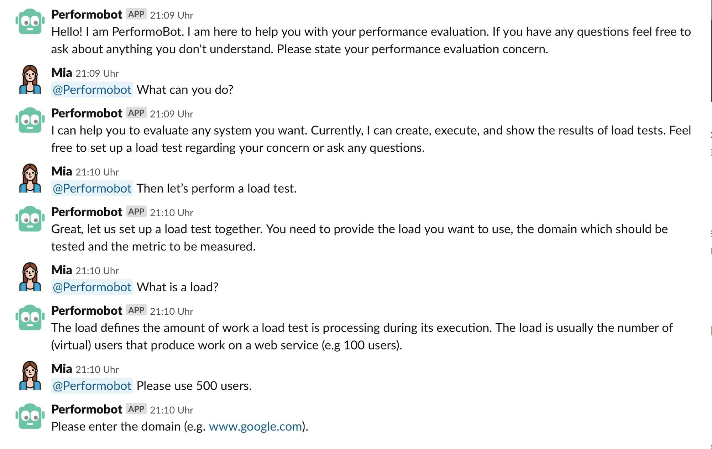
Demo
Notes:
Novice
Bot gives explanations

Slide 6
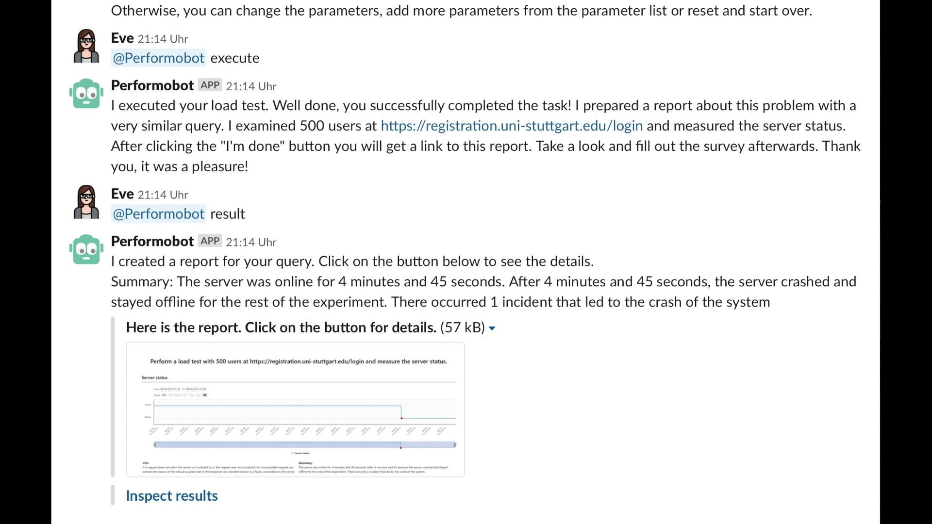
Demo
Notes:
Expert
Knows how do do load testing
Knows how to interact with bot

Slide 7





Study
: Research Questions
01
How can a chatbot help users do a performance evaluation through a load test?
Task
+
02
How do users interact with PerformoBot?
Survey
03
What educational effect does PerformoBot have on participants?
04
What are the differences between inexperienced users and experts in the above categories?
47 participants
Notes:
In order to inspect the usefulness of the bot we prepared a study
preparation of a scenario -> Registr@tion:
…
survey for participants
47 participants took part
In the evaluation of the study we focued on following questions
...

Slide 8

Study: Task + Survey
Performance Evaluation
Test System
chat
Participant
evaluate
8:00 min
PerformoBot
Survey
Notes:
setup in detail
participants were invited by a link to a website
there the scenario was described
participants were given 8 minutes to solve the problem of the system
test runs showed that 8 minutes should be enough (even with more elaborate conversations)
also, as we saw earlier, performobot is able to answer some questions that dont have anything to do with the scenario
when participant is finished performobot directed the user to a survey
Survey first established the background of participants, then asked about the task and lastly about pros and cons of using PerformoBot in general

Slide 9



Study: Results
Median of 10 interactions per participant
Average of 3.64 minutes session time
47 participants
No educational effect
87.2% finished the task
Automatic execution
&
report creation
80.9% correctly answered the scenario
Too little guidance
fallback mechanisms
&
missing keywords
Complex load testing capabilities
Explanations
Notes:
a look at the results
47 participants (almost as much novice users as experts)
10 interactions
~3.6 minutes were spent with the bot
positive feedback and findings:
users did not have to perform the analysis
~87% finished the task -> ~81% answered the with the correct solution
explanations were helpful to fill the interaction
negative feedback and findings:
we could not detect an educational effect on users
users were not motivated enough to ask questions
those who asked could not get a useful response for their questions
All but 2 participants knew performance evaluation beforehand
obviously not all users did complete the scenario -> to little guidance and fallback mechanisms
some questions could not be answered because keywords were missing in the bots knowledge
experts noted: real life scenarios are too complex to use chatbots

Slide 10
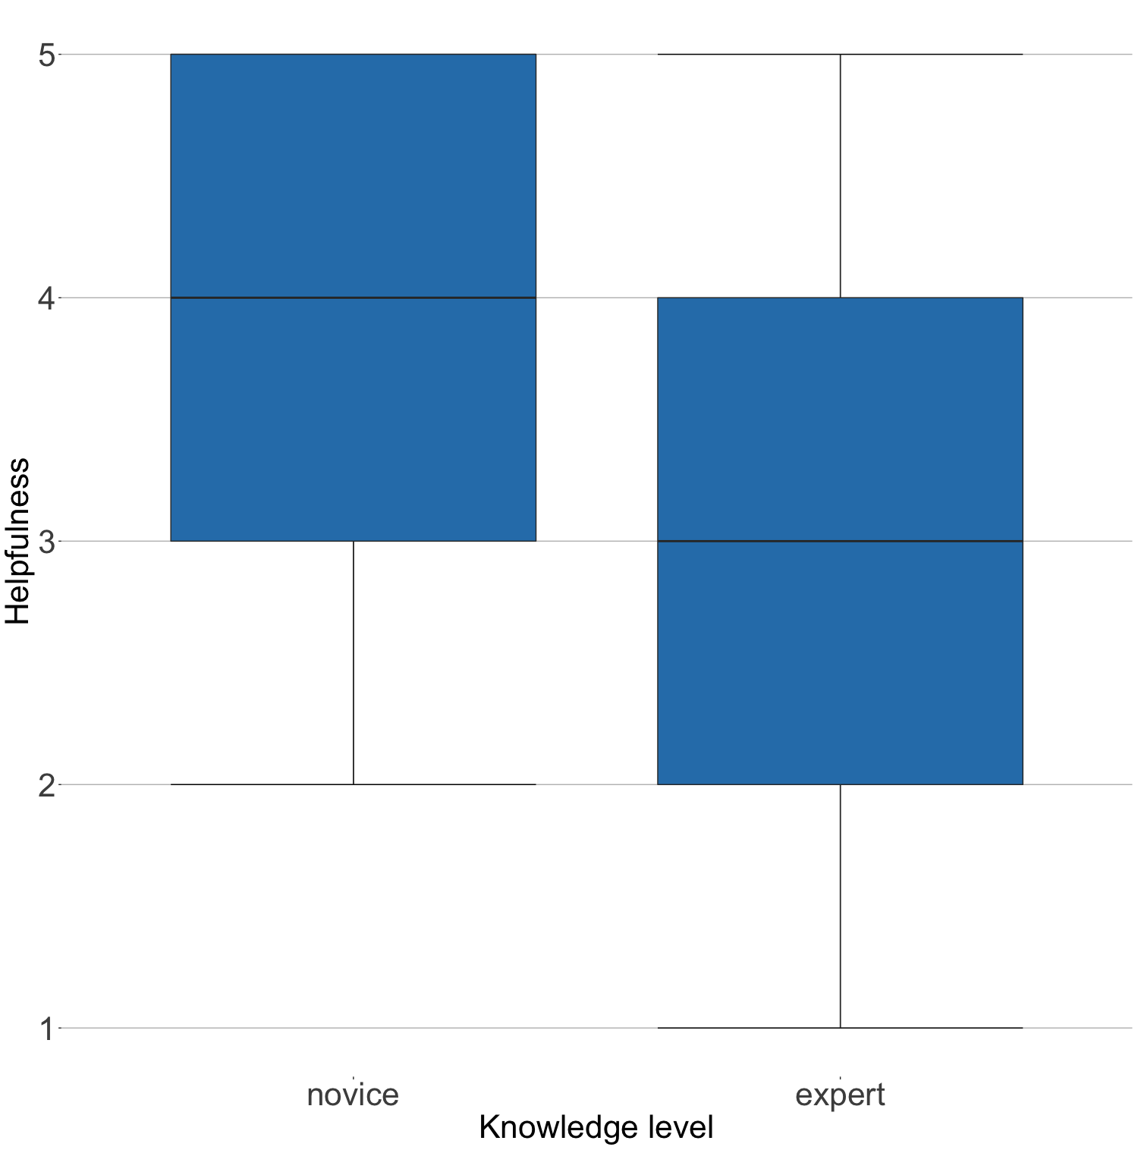
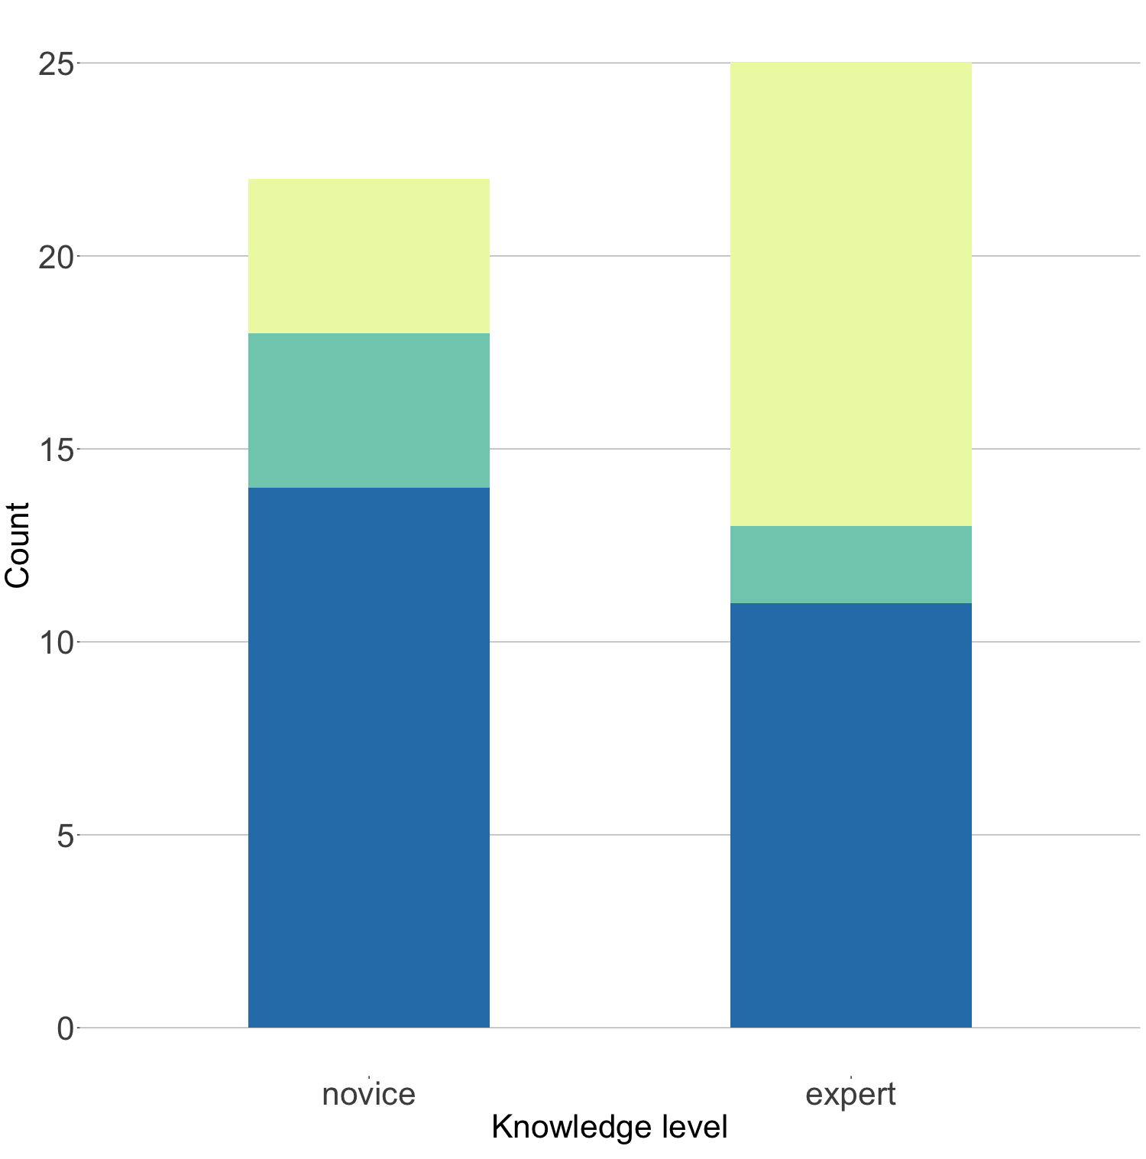
Study: Inexperienced Users vs Experts
Sentiment
22 novices and
25 experts
Helpfulness of PerformoBot
positive
neutral
negative
Very much
48.0%
18.2%
Novices and experts were equally able to successfully complete the task
18.2%
63.7%
8.0%
44.0%
Novices evaluated PerformoBot more positive and helpful
Not very much
Notes:
we took a focus on the comparison between the different experience levels
majority of novice users was satisfied with the current state of the bot
experts had a neutral feeling about the bot
this also shows when we asked the participants how much the bot helped them
novice users said that the bot helped them very much
experts again had a neutral feeling and saw room for improvement

Slide 11



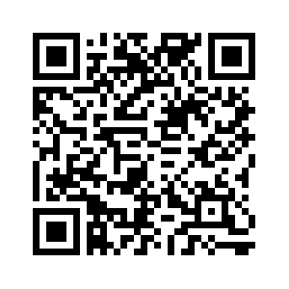
Conclusion
Mia
Colin
More performance concerns
Improved usability features
Helpful for novice/inexperienced users
Eve
Needs advanced functionality for experts
https://declare-project.github.io/PerformoBotSurveyWebsite/index.html
Notes:
in the end we saw that the bot is able to support the use cases for mia the manager and ben the buddy
if eve the expert wants to use performobot in her everyday life performobot requires some additional work
we can note that more performance concerns might help experts to use the bot in reallife
with a rework of some of the bots features we can improve the usability
if you are interessted to use performobot and solve the scenario have a look at our study page

Slide 12
Load test intents and entities
Intent: Load test Newbie
Output context: loadtest
Entities:
Analysis type
Training Phrases:
I want to create a load test.
Help me to define a load test.
I want to perform a load test.
Please perform a load test for me.
Great, let us set up a load test together. I need to know what load you want to use, the domain to be tested and the metric which should be measured.
Intent: Define a load test
Output context: loadtest
Entities:
Load
Domain
Metric
Analysis type (optional)
Duration (optional)
Training Phrases:
Loadtest with 55 users
I want one with 3 hours, 22 users and response time.
Create a load test with 30 users at www.myservice.de and measure server status.
Record the response time for 100 users on www.example.com.
Alright I created a load test for you with the following parameters: load: 100 users, domain: www.example.com, metric: response time. If you are satisfied I can execute the load test. Otherwise, you can change the parameters, add more parameters from the parameter list or reset and start over.

Slide 13
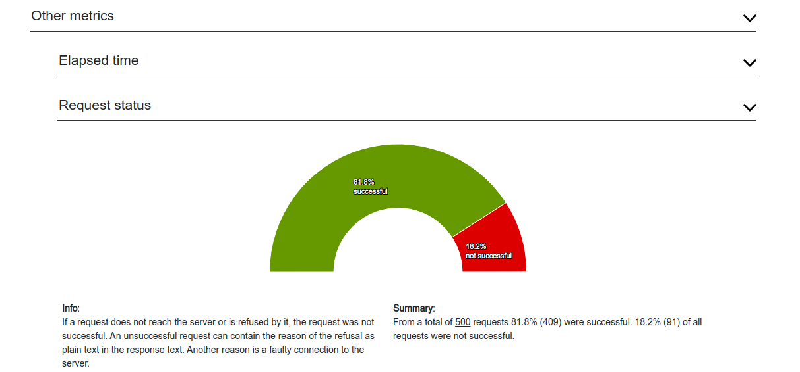
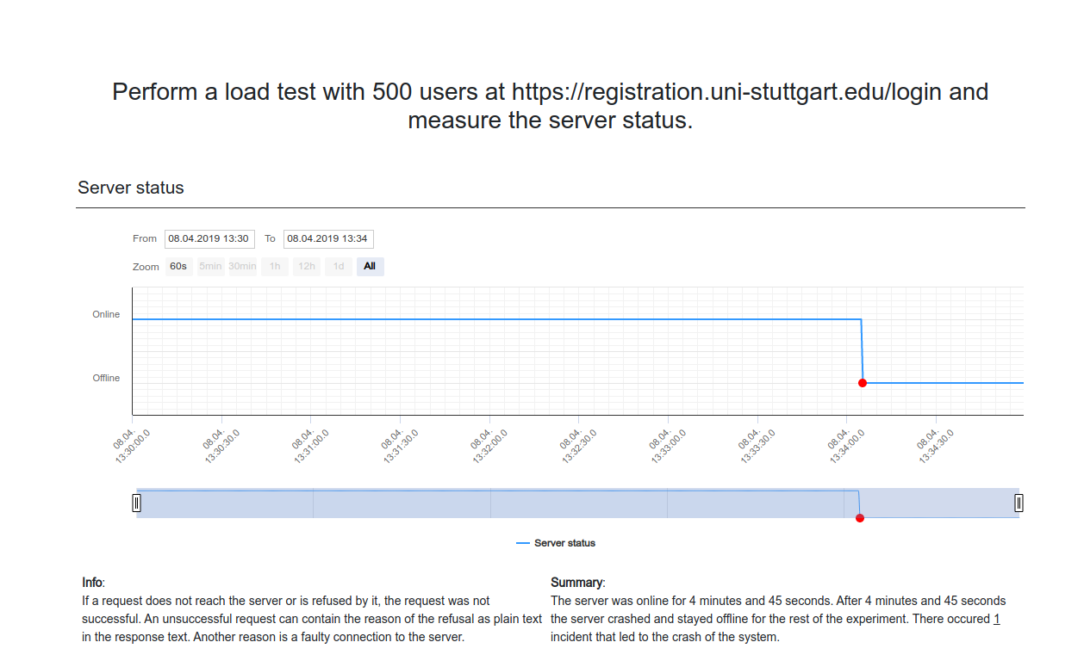
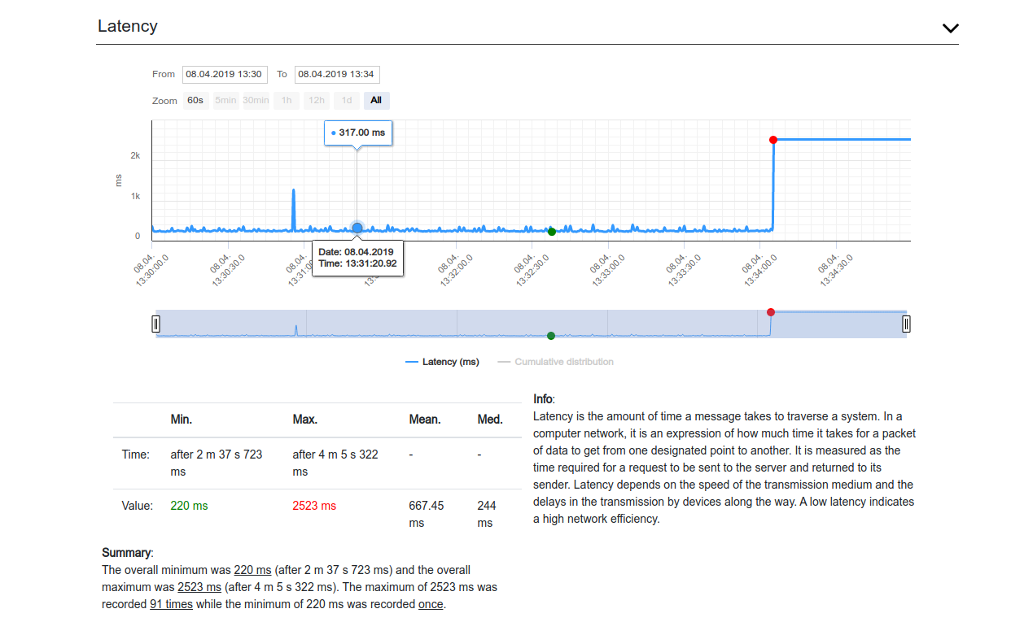
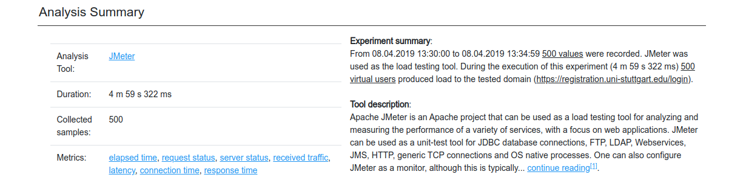
Performance Report
1
3
2
4

Slide 14
References
Icons from flaticon (https://www.flaticon.com/) made by dave-gandy (question mark), monkik (people), freepik, eucalyp, smashicons (analysis, computers, clocks), flat-icons (performobot), roundicons (check mark, x, smileys)
chatbot gif: https://cdn.dribbble.com/users/37530/screenshots/2937858/drib_blink_bot.gif
Messages gif: https://i.gifer.com/origin/98/98447b873b927d46f752e9e0fc9c2910_w200.gif
Okanović et al., <under review>: Dušan Okanović, Samuel Beck, Lasse Merz, Christoph Zorn, Leonel Merino, André van Hoorn, Fabian Beck: Can a Chatbot Support Software Engineers with Load Testing? Approach and Experiences. Under review

